Slide 1



Optimizing Resource Allocation: Exploring Trade-offs in Multiphase Sampling for Time and Cost Savings
A Study in Falling Number data-sets
David Hughes¹
Alison Smith¹, Marijka Batterham¹ & Brian Cullis¹
Biometrics in the Bay of Islands 2023
¹Mixed Models and Experimental Design Lab (MMaED) National Institute for Applied Statistics Research Australia, University of Wollongong, Wollongong, NSW
hughesd@uow.edu.au
@DaveDoesStats @uowMMaED
Notes:
Hello all,
My name is David Hughes, I’m a PhD student at university of Wollongong, supervised by Brian Cullis, Alison Smith and Marijka Batterham, and this work was in collaboration with William Fairlie from AGT.

Slide 2


Acknowledgements
Haydn Kuchel and William Fairlie (AGT)
GRDC
Nicole Cocks
PhD Supervisors
Notes:
Before I start, I’d like to thank AGT: Hayden Kuchel and William fairlie, and GRDC for the use of their data.
I’d also like to thank my previous colleague Nicole Cocks for her work in establishing the foundation of this project,
and finally thank you to my PhD supervisors.

Slide 3
Content
Motivating Data-set
Estimation of Sources of Variation
Simulation Experiment
Model Formulation via Design Tableau
Variance Component Estimates
Aims and Structure of Experiment
Simulation Results
Multiphase Data
Design Sets
K-means Clustering
Context
Notes:
Here’s a brief outline of my talk, First I will provide some context, talk about my motivating dataset, before discussing the estimation of sources of variation in a multiphase experiment. Finally, I will discuss my simulation experiment.

Slide 4
Context
Late maturity α-amylase (LMA) expression is one of the many challenges facing the Australian wheat breeding industry.
LMA is an enzyme that breaks down starch into sugars during germination, leading to poor quality wheat end-products.
LMA is typically measured using a Falling Number test or ELISA assay, both of which are time consuming and expensive.
Notes:
Read bold parts

Slide 5
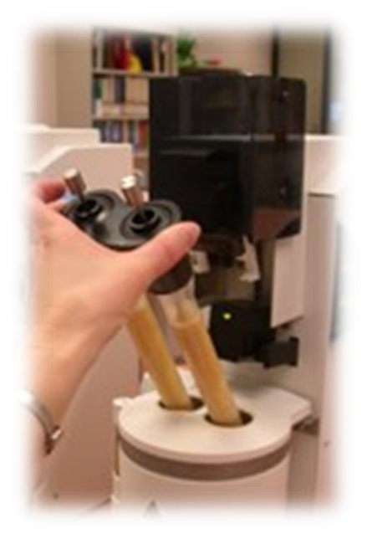
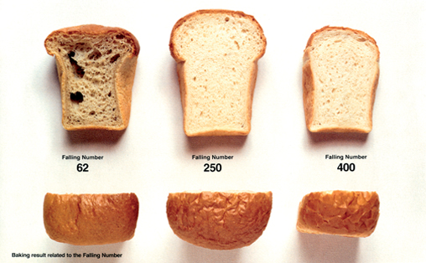
Measuring LMA
Notes:
Briefly, here’s an example of a Falling number machine.
The procedure involves creating a slurry from grain samples in either Tube of this machine. This is mixed using a rod. This rod is then released from the top and the Falling number measurement is the time it takes the rod to reach the bottom of the tube in seconds.
You can see that this procedure takes a long time…
A lower FN means that there is less starch in the product. Typically due to either pre-harvest sprouting or our trait of interest, LMA.
On the right we can see how the end-product is affected with low to high falling numbers. If wheat grain sold by a farmer has a low falling number, they can expect to receive less money for it.

Slide 6
The Problem – Resource Allocation
It’s important to determine if a variety is genetically predisposed to expressing LMA before selling on the market. This expression is influenced by the Variety’s interaction with the Environment (VEI), and hence would require widespread field trials to capture many environmental characteristics.
There are time and money thresholds to the number of varieties that can be tested due to the multiphase nature of the FN procedure.
How do we best allocate resources to maximise prediction accuracy in finding LMA expressors?
Notes:
What’s important in LMA testing is that this expression is influenced by variety and environment interactions. So it is imperative to test material in many field trials to capture many environmental characteristics.
However, there are thresholds in time and money to the number of varieties that can be tested to due to the multiphase nature of the FN procedure.
So the question is::::: How do we best allocate resources to maximise prediction accuracy in finding LMA expressors?

Slide 7
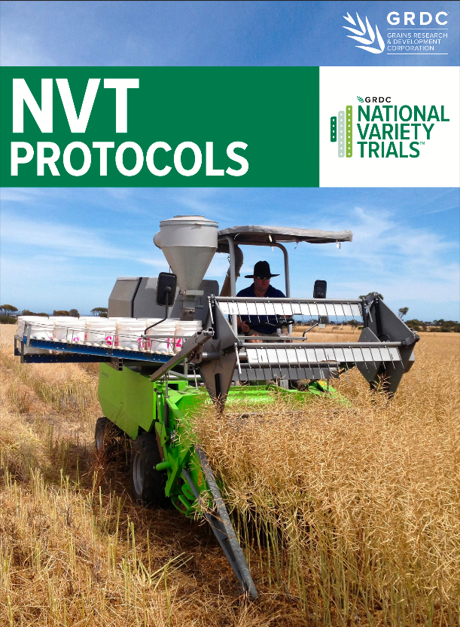
https://nvt.grdc.com.au/__data/assets/pdf_file/0045/588897/NVT-PROTOCOLS-v1.7-JUNE-2023.pdf
Notes:
Well let’s look at what is currently done across Australia?
One example is Australia’s biggest grain variety trials is the National Variety Trials.
Hundreds of independent grain trials are conducted all over Australia testing varieties in wheat, barley, canola, chickpea, just to name a few, that are available on the market for growers to buy.
Each trial is typically designed as ~20 varieties in a 3-rep RCBD design – Blocked in two directions.
Along with measuring yield, they also perform a range of grain quality tests. Here is their protocol booklet found online.

Slide 8

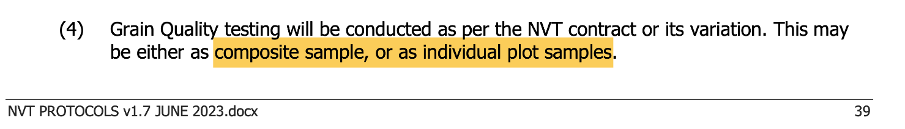
https://nvt.grdc.com.au/__data/assets/pdf_file/0045/588897/NVT-PROTOCOLS-v1.7-JUNE-2023.pdf
Notes:
here’s an abstract of what they do for quality trait testing….
“composite sample or individual plot samples”… no mention of design or number of laboratory duplicates… nothing. Just vagueness.
Is this good enough? Well let’s investigate!

Slide 9
Previous work in this space
There’s been numerous simulation studies into sampling methods conducted in the past.
See Cullis (2003), Smith et al. (2006), Smith et al. (2011), Smith et al. (2015)
What makes this unique?
Notes:
Now I know there are some people in the room who have conducted work in this space too, here’s a few examples of some. And you’re probably asking ”well what’s novel about this work?”
Well it all boils down to this wonderful data-set that we’ve got.

Slide 10
Motivating FN Data-set
208 designed field trials across Australia over the period 2014–2019.
Trials sourced through GRDC or AGT.
A total of 124 varieties across 208 retained trials.
But what’s so special about this data-set?
It features Field AND Lab Designs!!
Year | Source | #Trials | #Varieties
2014 | GRDC | 19 | 24
2015 | GRDC | 57 | 25
2016 | GRDC | 54 | 24
2017 | GRDC | 42 | 24
2018 | GRDC | 15 | 24
2019 | AGT | 21 | 123
Notes:
Essentially, our dataset has 208 field trials. These were sourced through AGT and GRDC, so they vary in the number of varieties, as shown on the right.
This data set contains 124 unique varieties across 208 trials,
and differ slightly among their field and laboratory phase designs. But that’s right, there are trials within this dataset that feature a valid design in both phases of the experiment.

Slide 11

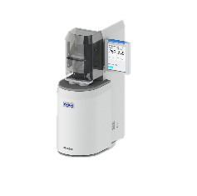
Design Sets
Notes:
Graphically this is how our phase designs look.
GRDC field trials feature a simple 2 rep RCBD field design with 24 varieties, and some lab design on the right that takes into account the number of machines and timings
WE can distinguish trials in our dataset corresponding to differences in design in each of these phases…. For example

Slide 12



Design Sets - A
Notes:
Set A has no information from the lab – almost like a black box.
Furthermore, there are is only one response per field plot, making it impossible to partition the variation from each phase.

Slide 13
Design Sets - B
No valid randomisation
Notes:
Set B is similar to Set A, however we now have pertaining to the machines that were used,
but still only one observation per plot and no valid randomisation within the lab (that is, systematic bias…)

Slide 14
Design Sets - C
No valid randomisation
Notes:
In Set C, we finally get replication in the laboratory,
so we’re able to partition some of the variation from field and lab, however, still no valid design was used in the lab and we still expect some systematic bias.

Slide 15
Design Sets - D
Notes:
Set D is when things start getting good..
Here we have some GRDC trials first designed by Nicole Cocks that featured a proper randomisation in both phases of the experiment.
With differing levels of duplication within the laboratory, that is, some get two and half the varieties get an extra two for one field rep.
There are 27 experiments that fall into this design set

Slide 16
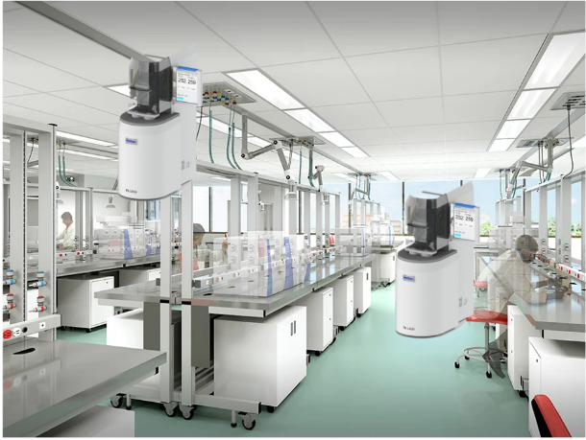
Design Sets - E
Notes:
Set E contains data from William Fairlie at Agt.
Here he expanded the field trial to ~105 varieties in a partially repped design in both phases.
Known as a p/q-rep design.
There are 21 experiments within our data set with this design.

Slide 17

Design Sets - E
Notes:
The design for this set is quite technical so let’s explore it in more detail using an example trial from the dataset:
For the field phase:
And for the Lab

Slide 18
2 field replicates
1 lab sample each
1 field replicate
2 lab samples (duplicates)
1 field replicate 1 lab sample
105 unique varieties
(66=1rep, 39=2rep)
p-rep% = 37.1%
144 Field Plots
Notes:
This was a p-rep design where the replicate blocks are outlined by the dark line (i.e. column blocks).
Plots shaded (dark grey) are field replicated plots and plots shaded (light grey) and (white) have only one field replicate.
There were 105 unique varieties, with a p-rep percentage at 37.1%.
These were sown in a field with 24 ranges and 6 rows, which gives 144 field plots.
Upon harvest, it was decided that Field plots with 2 reps would each have a lab sample.
Half of the varieties with one rep in the field were to be duplicated in the laboratory phase so that they had 2 lab samples (light grey).
And the other half of varieties with one rep in the field would only have a single laboratory sample (white plots)
Hence, there were 177 samples from which a FN measurement will be taken in the laboratory phase.

Slide 19
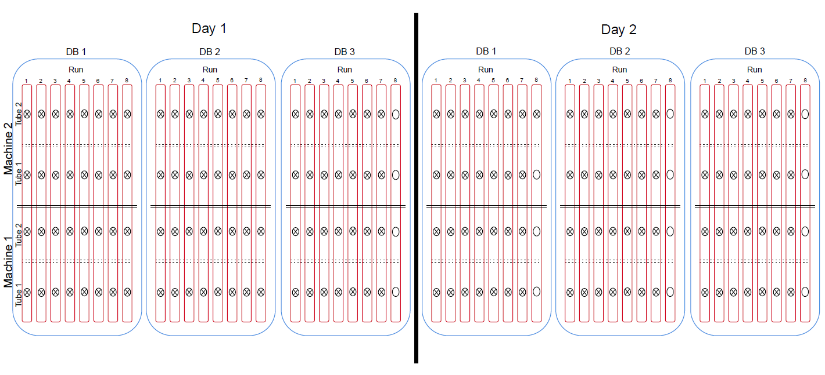
105 unique varieties
144 Field Plots
177 Laboratory Samples
q-rep% = 22.9%
Notes:
Here is a graphical representation of the laboratory phase of this example trial.
As mentioned earlier, field plots were partially replicated in such a way that from the 144 field plots, we now had 177 laboratory samples, giving a partial replication percentage in this phase of 23%.
Each of those Laboratory samples processed are depicted by crossed circles, and empty slots are depicted by open circles.
There was a maximum of two Machines, each with two Tubes, that measured falling number simultaneously.
Samples from trials were processed over a number of Days.
The randomised order of laboratory samples over the course of a Day were split into three RunBlocks (RB), corresponding to morning, midday, and afternoon.
Laboratory samples measured concurrently across Machines were denoted as a Run (up to 8 within a RB).

Slide 20
Design Sets
Set | nExpt | nVar | nFP = nOU | Lab Factors | Lab Design | Tubes/ Slurry
A | 65 | 24 | Yes ☹️ | ❌ | ❌ | 1
B | 12 | 24 | Yes ☹️ | ✔️ | ❌ | 1
C | 83 | 24 | No 😃 | ✔️ | ❌ | 2
D (GRDC) | 27 | 24 | No 😃 | ✅ | ✅ | 2
E (BREEDER) | 21 | 105 | No 😃 | ✅ | ✅ | 1
Notes:
To summarise, here’s the main features of each of the Design Sets.
This is why this data-set is so important.
Because, unlike in previous simulation studies,
we now have a means to simulate sensible variance parameter estimates to investigate the sources of variation from either phase in this multiphase experiment for our GRDC and Breeder trials.
And now we can actually simulate and compare differences in phenotyping methods from a proper randomisation in each phase, to systematic processes, and other methods.
So how do we get a measurement of the sources of variation coming from each phase of these complex experiments to use in our simulation study?
The first thing we must do, is determine the model terms to fit in a linear mixed model.

Slide 21
Analysis – Design Tableau Model Formulation
Source | Model Term | F/R | Effects
Variety | Variety | R | 105
CBlock | CBlock | R | 2
Range | Range | R | 24
Row | Row | R | 6
Range: Row (FPlot) | residual | R | 144
OUs:
Field Plots (144)
CBlock (2)
Range (24)
Row (6)
Treatment:
Variety (105)
Plot Model Formula:
CBlock + Range*Row
Notes:
We utilised Smith’s design tableau procedure to determine the model to fit.
For the first phase, a field trial, we know that are observational units * are field plots * (of which there are 144).
And the associated plot factors * with these are the column blocks, ranges, and rows, each with the number of effects found in brackets.
The treatments * for this phase of the experiment are the * varieties of which there are 105.
And finally, the plot model formula is simply as such. *
Putting this into a table,* with all terms fitted as random and the number of effects on the right, here is our design tableau for the first phase.

Slide 22
Analysis – Design Tableau Model Formulation
OUs:
Slurries (177)
Day (2)
RunBlock (3)
Run (8)
Machine (2)
Tube (2)
Treatment:
Variety + CBlock + Range*Row
Plot Model Formula:
(Day/RunBlock/Run)* (Machine/Tube)
OUs:
Field Plots (144)
CBlock (2)
Range (24)
Row (6)
Treatment:
Variety (105)
Plot Model Formula:
CBlock + Range*Row
Notes:
Moving to the second phase, we know that our observational units * are the slurries* formed in each tube of a machine, of which there are 177.
The associated plot factors are as follows. *
It gets a bit complex for the treatments in this phase.*
Rosemary bailey defines treatments as the “entire description of what can be applied to an experimental unit”.
Thus, in the second phase, the treatment factors * comprise not only the varieties, but the complete set of factors associated with the field plots in which varieties were grown.
The plot model formula * for this phase is simply the * interaction between our temporal plot factors and equipment plot factors.

Slide 23
Source | Model Term | F/R | Effects
Variety | Variety | R | 105
CBlock | CBlock | R | 2
Range | Range | R | 24
Row | Row | R | 6
Range:Row (FPlot) | Range:Row | R | 144
Machine | Machine | R | 2
Machine:Tube | Machine:Tube | R | 4
Day | Day | R | 2
Day:Machine | Day:Machine | R | 4
Day:Machine:Tube | Day:Machine:Tube | R | 8
Day:RunBlock | Day:RunBlock | R | 6
Day:RunBlock:Machine | Day:RunBlock:Machine | R | 12
Day:RunBlock:Machine:Tube | Day:RunBlock:Machine:Tube | R | 24
Day:RunBlock:Run | Day:RunBlock:Run | R | 45
Day:RunBlock:Run:Machine | Day:RunBlock:Run:Machine | R | 89
Day:RunBlock:Run:Machine:Tube | residual | R | 177
Notes:
And here we have the complete design tableau for a multiphase FN experiment, where terms separated by the dashed lines correspond to each of the phases.

Slide 24
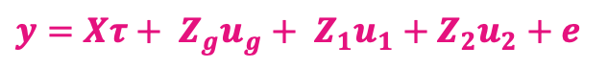
Random non-genetic effects:
Peripheral effects from each phase
Fixed effects: Overall Mean
$$y=Xτ+ Z_{g}u_{g}+ Z_{1}u_{1}+Z_{2}u_{2}+e$$
Random genetic effects: (Variety)
Residuals
Notes:
Here’s the Linear mixed model that we use for the analysis of an experiment within this data-set; for those that like to see algebra.
First term is our fixed effect which contains our overall mean.
Then we have our random genetic effects.
We have our random non-genetic peripheral effects from each phase, which were the designs implemented as shown in the previous slides.
note that the random effects have been split to correspond to the two phases of this multi-phase experiment.
And We have our residuals, which are gaussian zero mean independent and identically distributed.

Slide 25
Analysis – Results
Notes:
From our analysis, we can see that across all sets where it was able to partition the field and lab variation that there exists some notable non-genetic variation in each experiment.
Something that cannot be ignored.

Slide 26
Notes:
Here we can see the breakdown of field variation on the left, and laboratory variation on the right.
AS I mentioned previously, * It’s sets D and E that we will focus our simulation study on, and so we will be using values from the analyses of these experiments.
But how can we determine what numbers to use?
Simply put, it would be wrong to just average across the variance components from each of these trials,
because we would be losing certain features that can be found within groupings among the data.

Slide 27
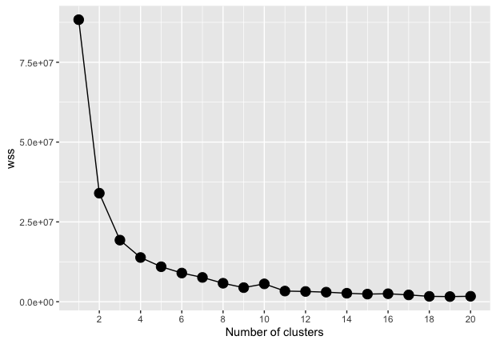
K-means Clustering
nExpt | Variety | CBlock | RBlock | Range | Row | FPlot
3 | 5359.758 | 71.970 | 2.613 | 92.839 | 168.441 | 0.000
33 | 1079.771 | 55.352 | 3.966 | 71.842 | 19.233 | 141.494
12 | 2853.993 | 95.190 | 4.119 | 78.298 | 66.720 | 180.623
nExpt | Machine | Machine: Tube | Day | Day: RunBlock | Day: RunBlock:Run | Day: Machine
3 | 0.000 | 2.665 | 40.406 | 14.255 | 0.000 | 0.000
33 | 14.610 | 46.767 | 14.630 | 14.626 | 38.256 | 4.213
12 | 50.271 | 66.322 | 44.311 | 44.440 | 60.024 | 19.136
Set | Cluster ID |  |  | nExpt
 | 1 | 1 (2) | 2 (3)
D (GRDC) | 2 | 16 | 9 | 27
E (Breeder) | 1 | 17 | 3 | 21
nExpt | Day:Machine: Tube | Day:RunBlock: Machine | Day:RunBlock: Machine:Tube | Day:RunBlock: Run:Machine | units!R
3 | 77.698 | 0.000 | 0.000 | 169.363 | 484.021
33 | 5.016 | 23.579 | 6.751 | 52.833 | 193.353
12 | 5.439 | 30.275 | 11.781 | 48.889 | 305.370
Notes:
So we used a K-means clustering algorithm to decide the variance components to use in our simulation.
We found that three clusters was sensible, and here’s how these two design sets in our dataset split across the 3 clusters.
A couple of things to note,
the first cluster is quite small, so we will disregard this in our simulations, and rename the others.
Another thing you might be thinking is
“ is it sensible to model variety effects from a large p-q-rep trial such as those in set E with the small 24 variety 2 rep RCBD.”
However you can see in the clustering that Set E is represented most in Cluster 2, and when you compare the variety effects for this cluster against the other, it's smaller, which we would expect to see.
Now it's Time to move on to the simulations!

Slide 28
Simulation Experiment - Aim
Good estimates of the sources of variation
We can investigate the sources of variation from different phenotyping procedures.
Aim: To compare the accuracies of these 3 forms of phenotyping:
“Gold Standard” – An efficient model-based design in field and laboratory. All field plots will be sampled for the lab. Designs are either fully or partially replicated (p/q-rep).
Composite – Using a basic field design (RCBD or p-rep), each variety field plot is composited and processed in systematic order
Single Field Plot per Variety – processed in systematic order.
Notes:
So now that we have good and meaningful estimates of the sources of variation one can expect from a Falling number experiment,
we can investigate the sources of variation from different phenotyping procedures.
Using the NVT protocols from earlier along with what is known to be done in private breeding companies through conversations,
we choose 3 forms of phenotyping to make comparisons of variety accuracies.
The gold standard, composite samples, and finally a single field plot per variety. I always find it hard to describe things with words, so let’s look at these through diagrams…

Slide 29
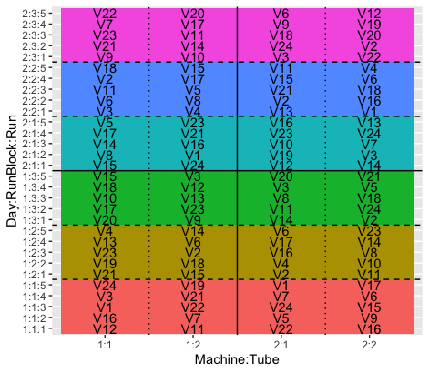
Simulation Study – Gold Standard
Notes:
The first is the gold standard, this involves an efficient model-based randomisation in both phases of the experiment, where all field plots are sampled for the lab in either a fully or partially replicated manner.
We will use GRDC-type trials to explain each phenotyping methodology, however, these are simple to scale to a breeder trial.
Here are our field plots on the left and laboratory samples on the right. You can see that we’ve allocated to these varieties as per our ODW designs.
Each field plot will get two lab dups and half of the varieties will get an extra 2 dups for a single rep, of which was decided by ODW.

Slide 30
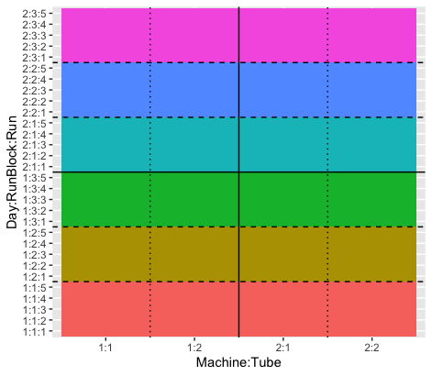
Simulation Study – Composite
Notes:
The second method is to composite samples. This involves using a basic rcbd or p-rep design in the field.
and combining each field plots from each variety.
we now only use the first 24 plots within the laboratory.
This is assuming that 2 machines were used, one can also do this with just one machine.

Slide 31
Simulation Study – Single Field Plot
Notes:
Finally, the third method is to randomly take a single field plot per variety (by sampling rep blocks), and again processed in systematic order within the laboratory.

Slide 32
Simulation Experiment – Methods
Set up field designs.
Construct the model-based laboratory design for the Gold Standard.
Generate full data vector based on the models detailed in the Design Tableau.
Compare correlations of the Composite and Single Field Plot methods against the Gold Standard nested within simulations.
Variance components are from the k-means clusters.
ODW() (see Butler & Cullis, 2023).
RCBD & p-rep.
Notes:
So here’s the workflow for our simulation study,
We design the field phase designs either as an RCBD or p-rep for GRDC-and breeder-type trials, respectively.
We then construct the model-based laboratory design for the gold standard using ODW (more details for this can be found in a recent paper by Butler and Cullis, also as discussed by Brian in his talk this morning)
We generate the full data vector based on the models detailed in the Design Tableau from earlier, taking variance components from each of the 2 k-means clusters.
Once this is all done, then we can test the composite and single plot phenology methods nested within simulations against the gold standard method.

Slide 33

Random effects + Residuals:
From each phase
Fixed effects: Overall Mean
$$y=Xτ+ Z_{g}u_{g}+ η$$
Random effects: (Variety)
Notes:
To accurately compare our alternating sampling methodology within simulations, we need to adjust our LMM from earlier.
We now group our non-genetic field and laboratory effects in this vector named eta, so our comparisons can be nested within simulations.

Slide 34
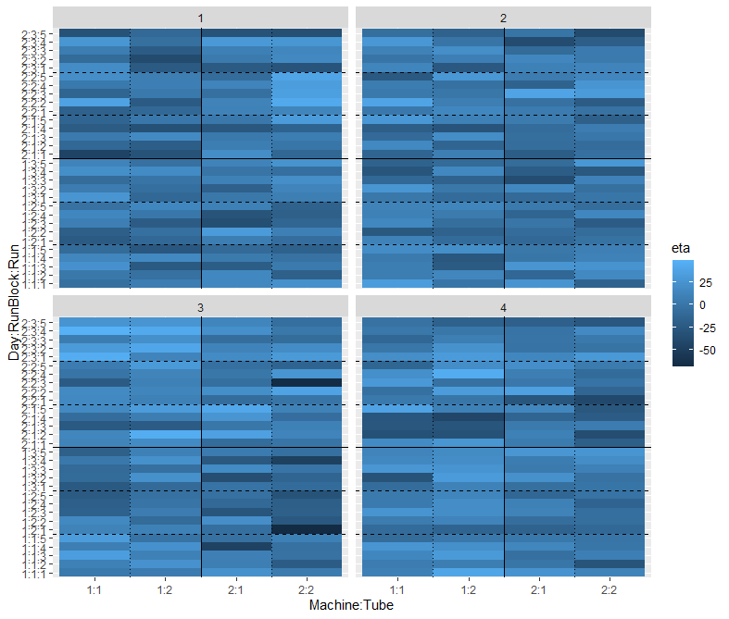
Simulation Study – Set Up
Notes:
So with some designs established, we can now perform our simulation study.
We generate 5000 simulations for a trial similar to our GRDC and breeder type trials for each of the 2 k-cluster means.
Here are some examples of how the field plot and laboratory sample plot effects look for our GRDC-type trials.

Slide 35
Set D (GRDC) Cluster 1
Notes:
We can look at the distribution from the simulated variance components for each term in the model for the 5000 simulations using dwreml.
As some of you know, the 0 counts are due to bound components. On each grid, I also plot what the true variance component value is.
I believe that we are able to estimate our field and lab variations quite nicely.
And note that while the laboratory components are quite small, it still exists.

Slide 36
Set D (GRDC) Cluster 2
Notes:
Briefly here’s the similar output for our second k-means cluster of these trial types.

Slide 37
Set E (Breeder) Cluster 1
Notes:
In our breeder type trials, we note similar things, however there are less laboratory components appear lower to the partially replicated design within the laboratory.

Slide 38
Set E (Breeder) Cluster 2
Notes:
And similarly for our second k-means cluster.

Slide 39
Component | Cluster 1 |  |  |  |  | Cluster 2
Component | TRUE | D (GRDC) |  | E (Breeder) |  | TRUE | D (GRDC) |  | E (Breeder)
 |  | Bias% | CV% | Bias% | CV% |  | Bias% | CV% | Bias% | CV%
Variety | 1079.771 | 0.40 | 33.8 | -0.24 | 20.7 | 2853.993 | -0.21 | 31.4 | -0.09 | 16.8
CBlock | 55.352 | 17.35 | 177.9 | 8.47 | 168.8 | 95.190 | 10.78 | 173.6 | 3.31 | 161.8
Range | 71.842 | -2.76 | 118.7 | 3.10 | 97.7 | 78.298 | 2.19 | 127.0 | 12.09 | 116.1
Row | 19.233 | 71.44 | 134.6 | 24.08 | 135.7 | 66.720 | 22.93 | 110.6 | 12.39 | 111.6
FPlot | 141.494 | -13.65 | 72.8 | 3.55 | 87.4 | 180.623 | -11.05 | 80.4 | 5.81 | 95.6
Notes:
Here I’ve made a table of the biases and CVs for each of these design sets and clusters for the variety and non-genetic field effects.
Note that large bias and CV values are due to the low corresponding component sizes.
AS we've seen, most of these terms do have a low number of degrees of freedom.

Slide 40
Component | Cluster 1 |  |  |  |  | Cluster 2
 | TRUE | D (GRDC) |  | E (Breeder) |  | TRUE | D (GRDC) |  | E (Breeder)
Component | TRUE | Bias% | CV% | Bias% | CV% | TRUE | Bias% | CV% | Bias% | CV%
Machine | 14.610 | 102.16 | 212.3 | 111.14 | 221.8 | 50.271 | 43.06 | 196.2 | 40.24 | 203.2
Machine:Tube | 46.767 | -19.22 | 124.3 | -19.91 | 126.1 | 66.322 | -17.43 | 125.9 | -19.49 | 133.5
Day | 14.630 | 49.03 | 203.6 | 38.86 | 209.6 | 44.311 | 34.58 | 187.1 | 24.01 | 195.5
Day:RunBlock | 14.626 | 36.24 | 156.6 | 34.28 | 162.4 | 44.440 | 2.49 | 132.1 | 1.34 | 142.8
Day:RunBlock:Run | 38.256 | 4.75 | 98.8 | 16.58 | 114.0 | 60.024 | 2.47 | 97.2 | 15.38 | 112.8
Day:Machine | 4.213 | 72.58 | 252.0 | 81.88 | 272.1 | 19.136 | -10.04 | 225.4 | -4.64 | 255.6
Day:Machine:Tube | 5.016 | 42.26 | 207.2 | 81.36 | 245.0 | 5.439 | 87.21 | 223.8 | 179.13 | 241.5
Day:RunBlock:Machine | 23.579 | -29.44 | 156.0 | -28.95 | 171.2 | 30.275 | -20.47 | 158.7 | -15.95 | 177.2
Day:RunBlock:Machine: Tube | 6.751 | 70.00 | 177.4 | 92.41 | 188.3 | 11.781 | 53.08 | 175.0 | 83.38 | 181.9
Day:RunBlock:Run: Machine | 52.833 | 1.69 | 95.8 | 11.99 | 115.2 | 48.889 | 20.48 | 116.7 | 48.85 | 133.4
units!units | 193.353 | -6.00 | 28.7 | -14.62 | 50.5 | 305.370 | -7.29 | 27.8 | -20.09 | 52.4
Notes:
Here’s another table, however, this time looking at the laboratory effects.
Similarly here, high bias values and CVs are due to small component sizes… Note again that Biases for Set E are on average larger due to the partially replicated nature of the laboratory designs.
However, we’re quite happy with how these estimated variance components across design sets for each cluster.
I need to say that this is something that would NOT have been possible without our motivating data-set.

Slide 41
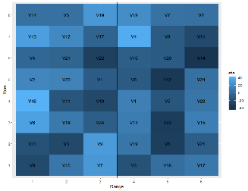
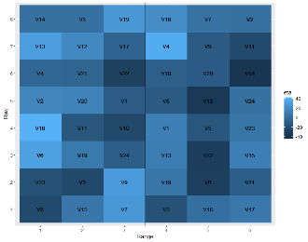

Set D – GRDC
Cluster | # Lab Dups | Correlations to True Variety Values
 | nDup | Gold | Comp | Single
1 | 4 | 0.909 | 0.811 | 0.778
1 | 6 | 0.918 | 0.811 | 0.778
2 | 4 | 0.941 | 0.873 | 0.849
2 | 6 | 0.945 | 0.873 | 0.849
-11.5%
-15.1%
Notes:
Let’s compare some phenotyping methodologies now.
Here’s a table comparing the correlations to the true variety values within each of our phenology methods for GRDC-type trials.
It’s great that we have the ability to model the variation within each phase, as this provides good insight into these correlations.
Note that in our GRDC-type trials, half of the varieties featured a field plot with an extra pair of lab duplication, hence we separate our correlations into the number of lab duplicates for each k-means cluster group.
Going across methods, we can see a decrease in correlations. In the worst cases, the composite method has a decrease of 11.5% [CLICK], and even more so the single plot method decreases by 15.1% [CLICK]. This shows why it is important to account for the lab variation.
I just want to reiterate that this is something that we were able to simulate and test due to our amazing motivating dataset.
What is good to see, is that as we go down the gold method column, correlations increase with more lab duplication.

Slide 42
Set E – Breeder
Cluster | Field:Lab Dups | Correlations to True Variety Values
 | nDup | Gold | Comp | Single
1 | 1:1 | 0.812 | 0.777 | 0.777
1 | 1:2 | 0.856 | 0.779 | 0.779
1 | 2:2 | 0.891 | 0.812 | 0.776
2 | 1:1 | 0.884 | 0.849 | 0.849
2 | 1:2 | 0.914 | 0.850 | 0.850
2 | 2:2 | 0.936 | 0.873 | 0.850
-9.0%
-12.9%
Notes:
Moving onto the breeder type trials, there are a few interesting things happening in this table.
As before, we separate our correlations according to the number of field and lab replications a variety and its field plot had.
Note how the correlations stay the same between the composite and single rep testing methods for the single field rep varieties, which makes sense.
The reduction in correlation from the golden method that we’re seeing in the first row must be caused by not utilising a valid statistical design (i.e. randomisation) within the laboratory, something that is only possible to see due to our motivating data-set. Moving along each row shows how accounting for the lab variation is important.
Another key result from this table is that we can see the progression of gold going down the column shows why lab duplication is important.
Whereas the extra effort for compositing samples v single plot doesn’t have bang for buck.
In some of the worst cases we can see a reduction in correlation from the true values of in the composite method of 9% [CLICK],
And in the single field plot method, we see a reduction of 13% [CLICK].
These can have catastrophic results if a variety ends up being marketed that was believed to not express LMA, when it truly does. Or inversely, a breeding company could lose money missing out on a killer variety due to a false belief that it expresses LMA.

Slide 43
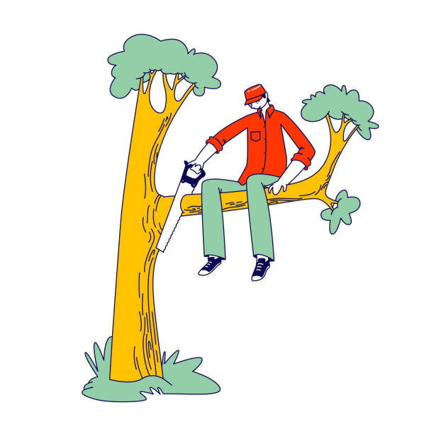
Is it worth it?
-11.5%
-9.0%
-15.1%
-12.9%
Notes:
So that leads us to ask the question. Is making cuts to time and budget constraints by compositing samples or choosing a single field plot a sensible thing to do or are you just shooting yourself in the foot in the long run?
I do understand that it is no easy feat to test every single field plot with multiple duplication so what I hope to achieve next is to simulate a method that can provide decent accuracy while still saving time and money.
Thank you.

Slide 44
References
Butler, D., & Cullis, B. R. (2023). “On Model Based Design of Comparative Experiments in R.” Submitted for publication.
Butler, D. (2023). “odw: Generate optimal experimental designs.” R package version 2.1.6.
Hughes, D. G. D., Fairlie, W., Batterham, M., Smith, A. B., & Cullis, B. R. (2023). “On the Use of Factor Analysis and iClasses to Assess Variety by Environment Interactions in Falling Number Across Australia.” Manuscript in preparation.
Mares, D. J., & Mrva, K. (2014). “Wheat grain preharvest sprouting and late maturity alpha-amylase.” Planta 240 (6):1167–1178
Smith, A. B, Lim, P., & Cullis, B. R. (2006). “The design and analysis of multi-phase plant breeding experiments.” The Journal of Agricultural Science, 144(5), 393-409.
Smith, A. B., Thompson, R., Butler, D. G., & Cullis, B. R. (2011). The design and analysis of variety trials using mixtures of composite and individual plot samples. Journal of the Royal Statistical Society Series C: Applied Statistics, 60(3), 437-455.
Smith, A. B., Butler, D. G., Cavanagh, C. R., & Cullis, B. R. (2015). Multi-phase variety trials using both composite and individual replicate samples: a model-based design approach. The Journal of Agricultural Science, 153(6), 1017-1029.
Smith, A. B., & Cullis, B. R. (2018). “Plant Breeding Selection Tools Built on Factor Analytic Mixed Models for Multi-Environment Trial Data.” Euphytica 214 (8).
Smith, A. B., Norman, A., Kuchel, H., & Cullis, B. R. (2021) “Plant Variety Selection Using Interaction Classes Derived from Factor Analytic Linear Mixed Models: Models with Independent Variety Effects.” Frontiers in Plant Science 12 (September).

Slide 45
Is it worth it?
-11.5%
-9.0%
-15.1%
-12.9%
Notes:
So that leads us to ask the question. Is making cuts to time and budget constraints by compositing samples or choosing a single field plot a sensible thing to do or are you just shooting yourself in the foot in the long run?
I do understand that it is no easy feat to test every single field plot with multiple duplication so what I hope to achieve next is to simulate a method that can provide decent correlation in accuracy while still saving the testing body time and money.
Thank you.

